Slide 1
AWS Architecture Icons
Release 22-2025.07.31

Slide 2
Release 22-2025.07.31: What’s New? 1/1
For the latest assets package and full resources, visit the AWS Architecture Center: https://aws.amazon.com/architecture/icons/
Artificial Intelligence
Amazon Nova (updated icon) (slide 49)
Compute
Amazon Elastic VMware Service (slide 67)
Games
Amazon GameLift Servers (successor to Amazon GameLift) (slide 94)
Amazon GameLift Streams (slide 94)
Migration & Modernization
AWS Transform (slide 122)
Storage
Amazon S3 Vectors / Resource Icon (slide 151)

Slide 3
Contents
Introduction
System
Guidelines
Examples
Elements

Slide 4
Introduction
About the deck and guidance for getting started

Slide 5
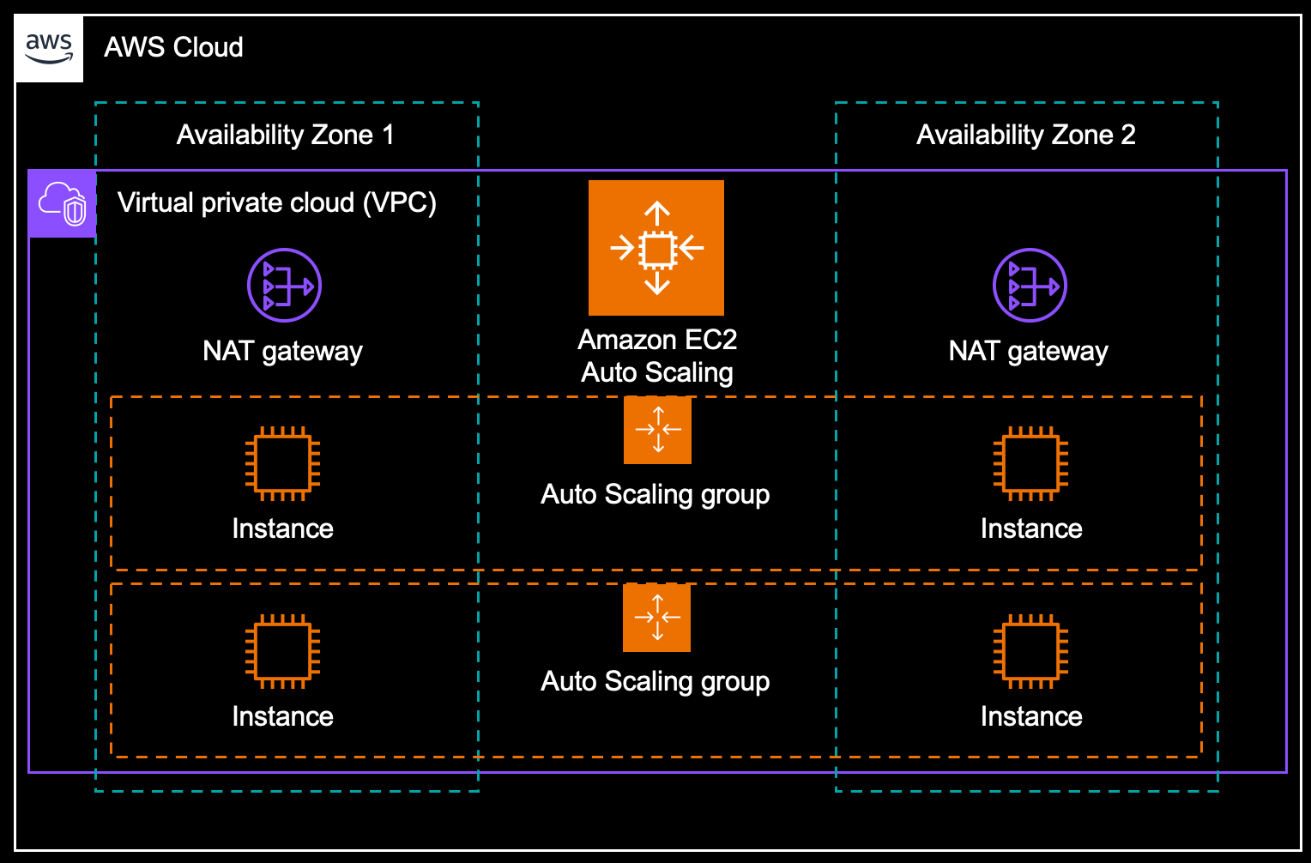
About AWS Architecture Icons
Architecture diagrams are a great way to communicate your design, deployment, and topology.
In this deck, you will find an official collection of AWS service icons, resource icons, additional assets and guidelines. These tools will help you build customer-focused and consistent AWS architecture diagrams.
Customers and partners can use AWS icons to create architecture diagrams. The icons are basic in design so that you can incorporate them directly into your whitepapers, presentations, datasheets, posters, or any technical material that you want.

Slide 6
Before You Begin:
1
Check for the latest deck update.
Download the latest deck from the AWS Architecture Center.
2
Read the guidelines.
For specific element guidance and best practices, see the guidelines section.
3
When in doubt, see the examples.
For completed diagrams, go to the example pages. If you’re having trouble with a particular layout or object, use these as a template.

Slide 7
System
A complete overview of the design system

Slide 8




System Elements 1/2
AWS Cloud
Groups
Show the connections between multiple services or resources
Arrows
Describe a flow of information or connect different parts of a diagram
Service icons
Represent an AWS service
Resource icons
Represent an AWS service resource
General resource icons
Apply to resources and objects for multiple AWS services and categories

Slide 9




System Elements 2/2
Group icon
AWS Cloud
Availability Zone 1
Availability Zone 2
Nested groups
Virtual private cloud (VPC)
Service icon
NAT gateway
Amazon EC2 Auto Scaling
NAT gateway
Auto Scaling group
Instance
Instance
Auto Scaling group
Resource icon
Instance
Instance

Slide 10
Guidelines
Diagram and element guidance

Slide 11
Building a Diagram
Choose your deck style. The architecture deck is available for both light and dark backgrounds. Determine which best fits your need – light backgrounds tend to be used on the web, while dark backgrounds are used for in-person presentations or slide decks.
Start with the structure. Locate the groups (see slides 23-24) to use for the underlying structure of your diagram.
Add architecture service or resource icons. If you downloaded the asset package from the AWS Architecture Center, you can search for your icon from your folder. Simply drag & drop or insert wherever you are building your diagram.
Connect the steps. Use the preset arrows to connect your steps and describe a workflow.
Add any final touches. You can use numbers to help convey a specific order within your diagram (see slide 16).

Slide 12
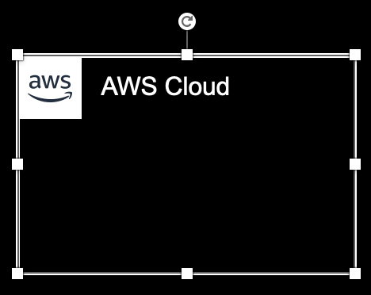

Groups
Each group consists of an icon and a label. Colors and lines help to differentiate groups to make it easier for the user to read a diagram at a glance. Some groups cross multiple groups, such as Auto Scaling, while others are meant to nest inside another, such as a VPC and subnets.
Resizing groups
Use the bottom-right corner of a group box to resize it.
Nested groups
When you have groups within groups, inner groups should have at least .05" buffer on all sides.
DO:
Use a generic group type if the presets do not suit your needs.
Add a custom group if needed (see slide 24).
Virtual private cloud (VPC)
Public subnet
DON’T:
Create groups with nonapproved AWS icon(s).
Resize group icons.

Slide 13

Icons
Architecture service and resource icons are designed to be used on both light and dark backgrounds. You can find the icons in the assets package download or in the PowerPoint presentation.
Resizing icons
All icons in this deck are SVGs, allowing them to be scaled up or down only when used in presentations. To preserve icon integrity, be sure to hold down Shift while resizing.
For diagrams, use icons at their predefined size and do not resize.
DO:
Use icons at their predefined size, color and format in diagrams.
Scale icons as needed for use in presentations.
Hold down Shift while resizing.
DON’T:
Crop service icons.
Flip or rotate icons.
Change icon shapes.

Slide 14

Arrows
Use arrows or lines to connect parts of a diagram or to show a workflow.
Use preset arrows
Copy the preset arrows into your diagram to maintain the correct formatting. To edit, click on the arrow and hold down Shift.
Create new arrows
Preset arrows use the “Open Arrow” in Size 4.
When in doubt, use the default
If the arrow shape that you need is not available in the sample arrows, use the default arrows.
DO:
Use the preset arrows provided in the Elements section.
Use straight lines and right angles to connect objects wherever possible.
In the instance where right angles are not possible, you may use a diagonal line as provided.
Default Arrow
+ Open Arrow
+ Size 4
Hold Shift
DON’T:
Use anything beside preset or default arrows.

Slide 15

Icon Labels
The icon and label are separated to allow for adjustment or abbreviation. All label text should be 12pt Arial throughout the diagram. General icons are flexible and their labels can be customized for your use-case. For example, the general “User” icon for Storage can also be used as “Profile” for Games.
Name wrapping and line breaks
AWS service names must fit on no more than two lines. AWS or Amazon should always be accompanied by the service name. Lines should never break mid-word.
DO:
Break a line after the second word in the service name if necessary.
DON’T:
Amazon QuickSight
Amazon QuickSight
Amazon Quick- Sight
Use short forms without first mentioning the full service name somewhere in the document.
Duplicate short forms for different services, such as ELB for Elastic Beanstalk and Elastic Load Balancing.
Break a line in the middle of a word.
Amazon should be on the same line as the first word in the service name.
Lines should never break mid-word, and should fit on two lines max.
Short forms
To save space when using a service multiple times in a diagram, you may use the short service forms instead of the full name. For example, Amazon EC2, instead of Amazon Elastic Compute Cloud.

Slide 16
Numbered Callouts
Use numbered callouts to draw attention to steps in a process within a diagram (as shown on slide 19). Callouts are white with bold black type so that they stand out among the colored service and resource icons in the diagram. Consult with your team to see if you can use numbered callouts.
Large callouts
For a simple diagram, you can use large callouts.
DO:
Use callouts at their predefined size, color and format.
Order your numbers as linearly as possible, such as left to right, top to bottom, or clockwise.
Be as consistent as possible in placement of the callouts.
1
2
3
4
5
6
7
8
9
10
Small callouts
For a complicated diagram, you can use small callouts.
DON’T:
Mix callout sizes within the same diagram.
Change color or font size within the callout.
Use letters or other symbols.
Manually size or stretch the callout shape.
Create new callout shapes.
1
2
3
4
5
6
7
8
9
10

Slide 17
Examples
The system in action

Slide 18



Example: Git to S3 Webhooks
AWS Cloud
Amazon S3
SSH key bucket
Git push
Third-party Git repository
Git webhook
Git users
AWS KMS key
AWS Lambda
Amazon S3 output bucket

Slide 19

Example: Chef Automate Architecture on AWS
AWS Cloud
Availability Zone
Chef Knife uploads cookbooks.
Knife bootstraps and communicates with nodes.
Chef client processes run list.
Virtual private cloud (VPC)
Internet gateway
Public subnet
1
Chef Automate
3
Chef workstation (local Chef repo)
2
Chef node
10.0.0.0/19
10.0.0.0/16

Slide 20
Elements
Resources to use when building your diagram

Slide 21
Icon Categories
Click a category to jump to slide (must be in Presentation mode)
General Resources
Analytics
Application Integration
Artificial Intelligence
Blockchain
Business Applications
Cloud Financial Management
Compute
Contact Center
Containers
Customer Enablement
Database
Developer Tools
End User Computing
Front-End Web & Mobile
Games
Internet of Things
Management & Governance
Media Services
Migration & Modernization
Networking & Content Delivery
Quantum Technologies
Satellite
Security, Identity, & Compliance
Serverless
Storage

Slide 22
General Resources

Slide 23












Groups 1/5
*
AWS Cloud
AWS Cloud
Region
Availability Zone
Security group
Auto Scaling group
Virtual private cloud (VPC)
Private subnet
Public subnet
Server contents
Corporate
data center
EC2 instance contents
Spot Fleet
AWS account
AWS IoT Greengrass Deployment
AWS IoT Greengrass
Elastic Beanstalk container
AWS Step Functions workflow
Generic group
Generic group
*
In certain AWS Regions (e.g., China), AWS does not own the rights for the logo using the letters “AWS.” Per our guidelines, use the group with the AWS logo except in Regions where the AWS logo cannot be used. You may use the group with the cloud icon in those cases.

Slide 24




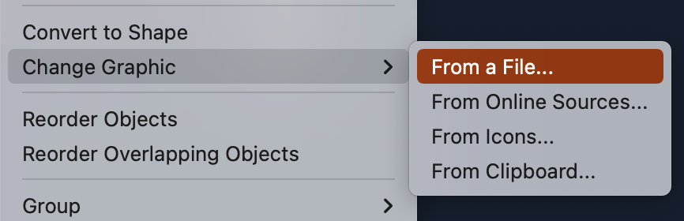
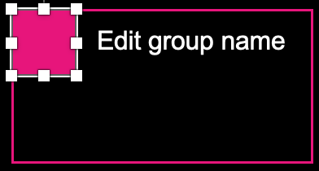



Create a Custom Group for a Service 2/5
Select a group with the category color where you find your service to start creating your custom group. All groups are fully editable.
Edit group name
Edit group name
Edit group name
Edit group name
Download the asset package. Go to the AWS Architecture Icons webpage and download the asset package to your desktop.
Begin customizing. In your chosen group, select the square icon and choose Change Graphic > From a File.
Find the service icon. Navigate to the Architecture-Service-Icons folder in the asset package. Then find the appropriate category folder where the service appears.
Insert the service icon. In the Arch_32 folder, select the architecture service icon SVG file, then click Insert. Do not choose a PNG file, image quality will be degraded.
Analytics
Games
Networking & Content Delivery
Serverless
Application Integration
Management & Governance
Cloud Financial Management
Internet of Things
Storage
Artificial Intelligence
End User Computing
Migration & Modernization
Edit group name
Edit group name
Edit group name
Blockchain
Compute
Containers
Media Services
Quantum Technologies
Business Applications
Contact Center
Front-End Web & Mobile
Security, Identity & Compliance
Customer Enablement
Database
Developer Tools
Satellite

Slide 25
Arrows 3/5

Slide 26



























General Icons 4/5
AWS Marketplace
Client
Mobile client
Disk
Server
Servers
Tape storage
Database
Cold storage
Data stream
Internet
Internet alt1
Internet alt2
Globe
Office building
Firewall
SAML token
SSL padlock
Credentials
Shield
Alert
Toolkit
SDK
User
Authenticated user
Users
Forums
Chat

Slide 27




















General Icons 5/5
AWS Marketplace
Multimedia
Programming language
Source code
Logs
JSON script
Document
Documents
Folder
Folders
Data table
Magnifying glass
Generic application
Email
Metrics, Data visualization
Git repository
AWS Management Console
Camera
Question
Gear
Recover

Slide 28

Analytics
STANDARD CATEGORY ICON

Slide 29









Analytics 1/6
Amazon CloudSearch
Amazon EMR
AWS Lake Formation
Amazon Kinesis
Search documents
Cluster
HDFS
cluster
Data lake
EMR engine

Slide 30




Analytics 2/6
Amazon Kinesis Video Streams
Amazon Kinesis Data Streams
Amazon Data Firehose
Amazon Managed Service for Apache Flink

Slide 31













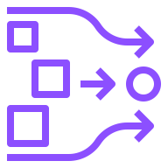
Analytics 3/6
AWS Glue
Amazon OpenSearch Service
Crawler
AWS Glue Data Catalog
Index
Data node
UltraWarm node
Cluster Administrator node
AWS Glue for Ray
AWS Glue Data Quality
OpenSearch Dashboards
Traces
Observability
OpenSearch Ingestion

Slide 32


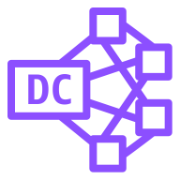
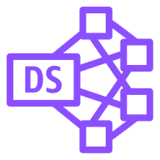
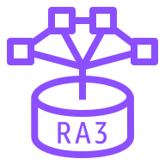






Analytics 4/6
Amazon Redshift
Amazon QuickSight
Amazon FinSpace
Dense compute node
Dense storage node
RA3
Query Editor v2.0
Paginated Reports
Redshift ML
Data sharing governance
Auto-copy
Streaming Ingestion

Slide 33






Analytics 5/6
Amazon Managed Streaming for Apache Kafka (Amazon MSK)
AWS Data Exchange
AWS Glue DataBrew
AWS Entity Resolution
Amazon MSK Connect
AWS Data Exchange for APIs

Slide 34








Analytics 6/6
Amazon DataZone
AWS Clean Rooms
Amazon Athena
Amazon SageMaker
Business data catalog
Data source connectors
Data portal
Data projects

Slide 35

Application Integration
STANDARD CATEGORY ICON

Slide 36










Application Integration 1/3
Amazon Simple Notification Service (Amazon SNS)
Amazon Simple Queue Service (Amazon SQS)
Amazon MQ
AWS AppSync
Email notification
Message
Broker
HTTP notification
Queue
Topic

Slide 37











Application Integration 2/3
AWS Step Functions
Amazon EventBridge
Event
Rule
SaaS
event bus
Default
event bus
Custom
event bus
Schema
Schema registry
Scheduler
Pipes

Slide 38




Application Integration 3/3
Amazon AppFlow
Amazon Managed Workflows for Apache Airflow (Amazon MWAA)
AWS B2B Data Interchange
AWS Express Workflows

Slide 39

Artificial Intelligence
STANDARD CATEGORY ICON

Slide 40




Artificial Intelligence 1/10
Amazon Comprehend
Amazon Elastic Inference
Amazon Forecast
Amazon Lex

Slide 41












Artificial Intelligence 2/10
Amazon Personalize
Amazon Polly
Amazon Rekognition
Amazon SageMaker AI
Amazon Rekognition image
Notebook
Canvas
Amazon Rekognition video
Model
Train
Shadow testing
Geospatial ML

Slide 42





Artificial Intelligence 3/10
Amazon SageMaker Ground Truth
Amazon Textract
Amazon Transcribe
Amazon Translate
Analyze Lending

Slide 43



Artificial Intelligence 4/10
AWS Deep Learning AMIs
AWS Deep Learning Containers
AWS DeepRacer

Slide 44



Artificial Intelligence 5/10
Apache MXNet on AWS
TensorFlow on AWS
AWS DeepComposer
Amazon Augmented AI (Amazon A2I)

Slide 45




Artificial Intelligence 6/10
Amazon Fraud Detector
Amazon Kendra
Amazon CodeGuru
PyTorch on AWS

Slide 46




Artificial Intelligence 7/10
Amazon Lookout for Metrics
Amazon Lookout for Vision
Amazon Monitron
AWS Neuron

Slide 47





Artificial Intelligence 8/10
Amazon DevOps Guru
AWS HealthLake
AWS Panorama
Amazon SageMaker Studio Lab
Insights

Slide 48




Artificial Intelligence 9/10
Amazon Comprehend Medical
AWS HealthOmics
AWS HealthImaging
AWS HealthScribe

Slide 49




Artificial Intelligence 10/10
Amazon Bedrock
Amazon Q
AWS App Studio
Amazon Nova

Slide 50

Blockchain
STANDARD CATEGORY ICON

Slide 51



Blockchain 1/1
Amazon Managed Blockchain
Amazon Quantum Ledger Database (Amazon QLDB)
Blockchain

Slide 52

Business Applications
STANDARD CATEGORY ICON

Slide 53



Business Applications 1/4
Alexa for Business
Amazon Chime
Amazon WorkMail

Slide 54






Business Applications 2/4
Amazon Connect
Amazon Pinpoint
Amazon Simple Email Service (Amazon SES)
Amazon WorkDocs
Journey
Email

Slide 55


Business Applications 3/4
Amazon Chime SDK
Amazon Pinpoint APIs
Amazon WorkDocs SDK
AWS Wickr

Slide 56



Business Applications 4/4
AWS Supply Chain
AWS AppFabric
AWS End User Messaging

Slide 57

Cloud Financial Management
STANDARD CATEGORY ICON

Slide 58




Cloud Financial Management 1/2
AWS Budgets
AWS Cost & Usage Report
AWS Cost Explorer
Reserved Instance (RI) Reporting

Slide 59


Cloud Financial Management 2/2
Savings Plans
AWS Billing Conductor

Slide 60

Compute
STANDARD CATEGORY ICON

Slide 61









Compute 1/7
Amazon Elastic Compute Cloud (Amazon EC2)
AMI
Auto scaling
Elastic IP address
Rescue
AWS Microservice Extractor for .NET
Instance*
DB instance
Instances
Spot Instance
Instance with CloudWatch
*Specify the instance type. Example labels: M5n instance, C4 instance, High Memory instance. Refer to the latest list of EC2 instance types.

Slide 62





Compute 2/7
AWS Elastic Beanstalk
AWS Lambda
Amazon Lightsail
Amazon EC2 Auto Scaling
Deployment
Lambda function
Application

Slide 63




Compute 3/7
AWS Outposts Family
AWS Outposts Rack
AWS Outposts Servers
AWS Serverless Application Repository

Slide 64




Compute 4/7
AWS Wavelength
AWS Local Zones
Amazon EC2 Image Builder
Bottlerocket

Slide 65




Compute 5/7
AWS ParallelCluster
Amazon DCV
Elastic Fabric Adapter
AWS Nitro Enclaves

Slide 66




Compute 6/7
AWS App Runner
NICE EnginFrame
Amazon Lightsail for Research
AWS Batch

Slide 67



Compute 7/7
AWS SimSpace Weaver
AWS Parallel Computing Service
Amazon Elastic VMware Service

Slide 68

Contact Center
STANDARD
CATEGORY ICON

Slide 69
Contact Center 1/1
Amazon Connect

Slide 70

Containers
STANDARD CATEGORY ICON

Slide 71














Containers 1/3
Amazon Elastic Kubernetes Service (Amazon EKS)
Amazon Elastic Container Registry (Amazon ECR)
Amazon Elastic Container Service (Amazon ECS)
Amazon ECS Anywhere
EKS on Outposts
Registry
Container 1
Container 2
Image
Container 3
Task
Service
ECS Service Connect
Copilot CLI

Slide 72




Containers 2/3
Amazon EKS Anywhere
Amazon EKS Cloud
Amazon EKS Distro
AWS Fargate

Slide 73

Containers 3/3
Red Hat OpenShift Service on AWS (ROSA)

Slide 74

Customer Enablement
STANDARD CATEGORY ICON

Slide 75




Customer Enablement 1/2
AWS IQ
AWS Managed Services
AWS Professional Services
AWS Support

Slide 76




Customer Enablement 2/2
AWS Training and Certification
AWS Activate
AWS re:Post
AWS re:Post Private

Slide 77

Database
STANDARD CATEGORY ICON

Slide 78

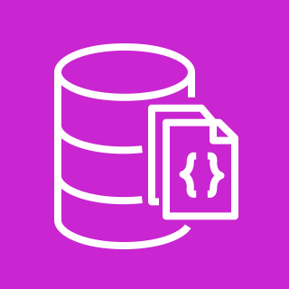









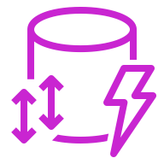



Database 1/5
Amazon Aurora
Amazon DocumentDB (with MongoDB compatibility)
Amazon DynamoDB
Trusted Language Extensions for PostgreSQL
Amazon DocumentDB Elastic Clusters
Attribute
Items
Amazon DynamoDB Accelerator (DAX)
Stream
Item
Table
Standard Access table class
Attributes
Global secondary
index
Standard–Infrequent Access table class

Slide 79





Database 2/5
Amazon Keyspaces (for Apache Cassandra)
AWS Database Migration Service (AWS DMS)
Amazon Neptune
Amazon Timestream
Database migration workflow or job

Slide 80






Database 3/5
Amazon Relational Database Service (Amazon RDS)
Amazon MemoryDB
Multi-AZ
Multi-AZ DB cluster
Blue/Green Deployments
Optimized Writes
Trusted Language Extensions for PostgreSQL

Slide 81

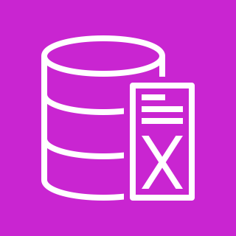




Database 4/5
Amazon ElastiCache
Oracle Database@AWS
ElastiCache
for Redis
ElastiCache for Memcached
ElastiCache for Valkey
Cache node

Slide 82











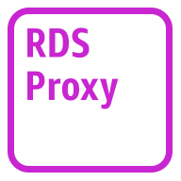
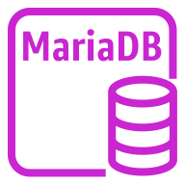



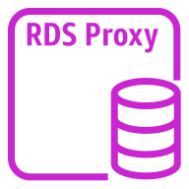
Database 5/5
Amazon Aurora instance
Amazon Aurora instance alternate
Amazon RDS instance
Amazon RDS
instance alternate
MySQL
instance
MySQL
instance alternate
Oracle
instance
Oracle
instance alternate
PostgreSQL instance
PostgreSQL
instance alternate
PIOPS instance
Amazon RDS
proxy instance alternate
MariaDB instance
MariaDB instance alternate
SQL Server
instance
SQL Server
instance alternate
Amazon RDS
proxy instance

Slide 83

Developer Tools
STANDARD CATEGORY ICON

Slide 84





Developer Tools 1/5
AWS Cloud9
AWS CodeBuild
AWS CodeCommit
AWS CodeDeploy
Cloud9

Slide 85



Developer Tools 2/5
AWS CodePipeline
AWS Command Line Interface (AWS CLI)
AWS Tools and SDKs

Slide 86




Developer Tools 3/5
AWS X-Ray
AWS Cloud Development Kit (AWS CDK)
AWS CodeArtifact
AWS CloudShell

Slide 87




Developer Tools 4/5
Amazon Corretto
AWS Cloud Control API
Amazon CodeCatalyst
AWS Infrastructure Composer

Slide 88

Developer Tools 5/5
AWS Fault Injection Service

Slide 89

End User Computing
STANDARD CATEGORY ICON

Slide 90






End User Computing 1/1
Amazon AppStream 2.0
Amazon WorkSpaces Family
Amazon WorkSpaces Thin Client
Amazon WorkSpaces
Amazon WorkSpaces Core
Amazon WorkSpaces Secure Browser

Slide 91

Front-End Web & Mobile
STANDARD CATEGORY ICON

Slide 92









Front-End Web & Mobile 1/1
AWS Amplify
AWS Device Farm
Amazon Location Service
AWS Amplify Studio
Track
Place
Map
Geofence
Routes

Slide 93

Games
STANDARD CATEGORY ICON

Slide 94



Games 1/1
Amazon GameLift Servers
Amazon GameLift Streams
Open 3D Engine
(successor to Amazon GameLift)

Slide 95

Internet of Things
STANDARD CATEGORY ICON

Slide 96









Internet of Things 1/6
FreeRTOS
AWS IoT Analytics
AWS IoT Button
AWS IoT Device Tester
Channel
Dataset
Pipeline
Notebook
Data store

Slide 97








Internet of Things 2/6
AWS IoT Core
AWS IoT Device Defender
AWS IoT Device Management
AWS IoT Events
Device Advisor
IoT device jobs
Fleet Hub
Device Location

Slide 98


















Internet of Things 3/6
AWS IoT Greengrass
AWS IoT SiteWise
Connector
Stream manager
Artifact
Component
Asset model
Asset
Asset hierarchy
Component machine learning
Component nucleus
Component private
Component public
Properties
Data streams
Interprocess communication
Protocol
Recipe
AWS IoT Device Tester

Slide 99



Internet of Things 4/6
AWS IoT ExpressLink
AWS IoT TwinMaker
AWS IoT FleetWise
AWS IoT Device Tester

Slide 100



























Internet of Things 5/6
IoT action
IoT actuator
IoT certificate
IoT desired state
IoT hardware board
IoT HTTP protocol
IoT HTTP/2 protocol
IoT MQTT protocol
IoT policy
IoT reported state
IoT rule
IoT sensor
IoT servo
IoT shadow
IoT simulator
IoT topic
Alexa skill
Alexa Voice Service
Alexa-enabled device
Echo
Fire TV
Fire TV Stick
Lambda function
Over-the-air update
Device gateway
AWS IoT Core for LoRaWAN protocol
LoRaWAN protocol

Slide 101


























Internet of Things 6/6
IoT thing bank
IoT thing bicycle
IoT thing camera
IoT thing car
IoT thing cart
IoT thing coffee pot
IoT thing door lock
IoT thing factory
IoT thing generic
IoT thing house
IoT thing lightbulb
IoT thing travel
IoT thing medical emergency
IoT thing police emergency
IoT thing utility
IoT thing windfarm
IoT thing humidity sensor
IoT thing vibration sensor
IoT thing temperature sensor
IoT thing temperature & humidity sensor
IoT thing temperature & vibration sensor
IoT thing relay
IoT thing stack light
IoT thing FreeRTOS device
IoT thing industrial PC
IoT thing PLC

Slide 102

Management & Governance
STANDARD CATEGORY ICON

Slide 103

















Management & Governance 1/9
Amazon CloudWatch
AWS Auto Scaling
AWS CloudFormation
Alarm
Rule
RUM
Cross-account observability
Change set
Stack
Event (time-based)
Event (event-based)
Evidently
Data protection
Template
Logs
Synthetics
Metrics Insights

Slide 104






Management & Governance 2/9
AWS Application Auto Scaling
AWS Config
AWS License Manager
AWS Health Dashboard
License blending
Application discovery

Slide 105




Management & Governance 3/9
AWS Management Console
AWS CloudTrail
AWS User Notifications
CloudTrail Lake

Slide 106


















Management & Governance 4/9
AWS Service Catalog
AWS Systems Manager
Automation
Documents
Patch Manager
Parameter Store
OpsCenter
Maintenance Windows
Inventory
State Manager
Run Command
Incident Manager
Session Manager
Change Manager
Change Calendar
Compliance
Application Manager
Distributor

Slide 107








Management & Governance 5/9
AWS Trusted Advisor
AWS Well-Architected Tool
AWS Control Tower
Checklist
cost
Checklist
performance
Checklist
security
Checklist
fault tolerant
Checklist

Slide 108







Management & Governance 6/9
AWS Organizations
AWS AppConfig
AWS Chatbot
AWS Backint Agent
Account
Organizational unit
Management account

Slide 109




Management & Governance 7/9
Amazon Managed Grafana
Amazon Managed Service for Prometheus
AWS Distro for OpenTelemetry
AWS Service Management Connector (SMC)

Slide 110




Management & Governance 8/9
AWS Proton
AWS Launch Wizard
AWS Resilience Hub
AWS Console Mobile Application

Slide 111



Management & Governance 9/9
AWS Resource Explorer
AWS Telco Network Builder
AWS Compute Optimizer

Slide 112

Media Services
STANDARD CATEGORY ICON

Slide 113






Media Services 1/6
Amazon Elastic Transcoder
Amazon Kinesis Video Streams
AWS Elemental MediaConnect
AWS Elemental MediaConvert
AWS Cloud Digital Interface
MediaConnect Gateway

Slide 114




Media Services 2/6
AWS Elemental MediaLive
AWS Elemental MediaPackage
AWS Elemental MediaStore
AWS Elemental MediaTailor

Slide 115

Media Services 3/6
AWS Elemental Conductor
AWS Elemental Delta
AWS Elemental Live
AWS Elemental Server

Slide 116



Media Services 4/6
AWS Elemental Appliances & Software
Amazon Interactive Video Service
AWS Elemental Link
AWS Deadline Cloud

Slide 117




Media Services 5/6
AWS Thinkbox Krakatoa
AWS Thinkbox Deadline
AWS Thinkbox XMesh
AWS Thinkbox Frost

Slide 118


Media Services 6/6
AWS Thinkbox Stoke
AWS Thinkbox Sequoia

Slide 119

Migration & Modernization
STANDARD CATEGORY ICON

Slide 120











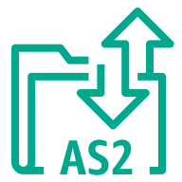




Migration & Modernization 1/3
AWS Application Discovery Service
AWS Transfer Family
AWS DataSync
AWS Migration Hub
Agentless Collector
AWS FTPS
AWS SFTP
Agent
Refactor Spaces services
Discovery Agent
AWS FTP
AWS AS2
Discovery
Refactor Spaces applications
Migration Evaluator Collector
Refactor Spaces environments

Slide 121








Migration & Modernization 2/3
AWS Application Migration Service
AWS Migration Evaluator
AWS Mainframe Modernization
Analyzer
Compiler
Converter
Runtime
Developer

Slide 122


Migration & Modernization 3/3
AWS Data Transfer Terminal
AWS Transform

Slide 123

Networking & Content Delivery
STANDARD CATEGORY ICON

Slide 124







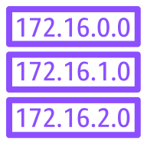







Networking & Content Delivery 1/6
AWS Transit Gateway
Amazon CloudFront
Amazon Route 53
Attachment
Download distribution
Edge location
Hosted zone
Route table
Readiness checks
Streaming distribution
Functions
Resolver
Resolver DNS firewall
Routing controls
Resolver query logging

Slide 125
















Networking & Content Delivery 2/6
Amazon Virtual Private Cloud (Amazon VPC)
Customer gateway
Internet gateway
VPN gateway
Flow logs
Endpoints
Router
Traffic mirroring
NAT gateway
Elastic network interface
Elastic network adapter
Network access control list
VPN connection
Peering connection
Reachability Analyzer
Carrier gateway
Network Access Analyzer
Virtual private cloud (VPC)

Slide 126













Networking & Content Delivery 3/6
AWS App Mesh
AWS Cloud Map
AWS Direct Connect
AWS Global Accelerator
Mesh
Virtual
gateway
Service
Gateway
Virtual node
Virtual router
Namespace
Virtual service
Resource

Slide 127








Networking & Content Delivery 4/6
AWS Client VPN
AWS Site-to-Site VPN
Elastic Load Balancing
AWS PrivateLink
Application Load Balancer
Network Load Balancer
Classic Load Balancer
Gateway Load Balancer

Slide 128







Networking & Content Delivery 5/6
AWS Cloud WAN
AWS Private 5G
Amazon VPC Lattice
AWS Verified Access
Segment network
Core network edge
Transit gateway route table attachment

Slide 129



Networking & Content Delivery 6/6
Amazon API Gateway
Amazon Application Recovery Controller
Endpoint

Slide 130

Quantum Technologies
STANDARD CATEGORY ICON

Slide 131










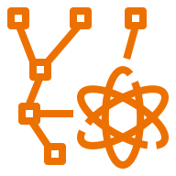



Quantum Technologies 1/1
Amazon Braket
Chandelier
Chip
QPU
Simulator
Simulator 1
Simulator 2
Simulator 3
Simulator 4
State vector
Tensor network
Noise simulator
Embedded simulator
Managed simulator

Slide 132

Satellite
STANDARD CATEGORY ICON

Slide 133

Satellite 1/1
AWS Ground Station

Slide 134

Security, Identity, & Compliance
STANDARD CATEGORY ICON

Slide 135





Security, Identity, & Compliance 1/7
Amazon Cloud Directory
Amazon Cognito
Amazon GuardDuty
Amazon Inspector
Agent

Slide 136





Security, Identity, & Compliance 2/7
Amazon Macie
AWS Artifact
AWS Certificate Manager (ACM)
AWS CloudHSM
Certificate authority

Slide 137

















Security, Identity, & Compliance 3/7
AWS Directory Service
AWS Firewall Manager
AWS Identity and Access Management (IAM)
Simple AD
Add-on
Permissions
MFA token
Role
AD Connector
AWS STS
AWS STS alternate
Long-term security
credential
IAM Access Analyzer
AWS Managed Microsoft AD
Encrypted data
Data encryption key
Temporary security credential
IAM Roles Anywhere

Slide 138







Security, Identity, & Compliance 4/7
AWS Key Management Service (AWS KMS)
AWS Secrets Manager
AWS Security Hub
AWS Shield
External Key Store (XKS)
Finding
AWS Shield Advanced

Slide 139











Security, Identity, & Compliance 5/7
AWS IAM Identity Center
AWS WAF
Amazon Detective
AWS Resource
Access Manager
Rule
Managed rule
Filtering rule
Labels
Bot
Bad bot
Bot control

Slide 140





Security, Identity, & Compliance 6/7
AWS Audit Manager
AWS Network Firewall
AWS Signer
AWS Private Certificate Authority
Endpoints

Slide 141




Security, Identity, & Compliance 7/7
Amazon Verified Permissions
Amazon Security Lake
AWS Payment Cryptography
AWS Security Incident Response

Slide 142

Serverless
STANDARD CATEGORY ICON

Slide 143
Serverless 1/1
Serverless is a way to describe the services that enable you to build and run applications without thinking about servers. AWS has serverless services for all layers of your stack. In many public forums, like our marketing website, we list these services under the Serverless heading because it improves discoverability.
When it comes to building an architecture diagram, it’s more intuitive to use a functional categorization. Please find the architecture icon for each serverless service in its functional category. You can use the serverless category icon to describe serverless applications or architectures.
To view the full list of Serverless Applications and learn more follow the link below:
Serverless on AWS »

Slide 144

Storage
STANDARD CATEGORY ICON

Slide 145















Storage 1/8
Amazon Elastic Block Store (Amazon EBS)
AWS Storage Gateway
Snapshot
Multiple volumes
Amazon Data Lifecycle Manager
Noncached
volume
Cached
volume
Amazon FSx
File Gateway
Volume
Volume gp3
Virtual tape
library
Tape
Gateway
Amazon S3
File Gateway
Volume
Gateway
File
gateway

Slide 146










Storage 2/8
Amazon Elastic File System (Amazon EFS)
AWS Elastic Disaster Recovery (AWS DRS)
Amazon FSx
File system
EFS Standard
EFS Standard–Infrequent Access
EFS Intelligent-Tiering
EFS One Zone
EFS One Zone–Infrequent Access
Elastic Throughput

Slide 147




Storage 3/8
Amazon FSx for Lustre
Amazon FSx for Windows File Server
Amazon FSx for NetApp ONTAP
Amazon FSx for OpenZFS
File system
File system

Slide 148







Storage 4/8
AWS Snowball Edge
AWS Snowball
Amazon File Cache
Snowball import-export
On-premises NFS linked datasets
Hybrid NFS linked datasets
S3 linked datasets

Slide 149




















Storage 5/8
AWS Backup
Backup plan
Backup vault
Virtual machine
Virtual machine monitor
AWS Backup Vault Lock
AWS Backup support for VMware workloads
AWS Backup for AWS CloudFormation
Recovery point objective
Recovery time objective
Database
Storage
Legal hold
AWS Backup support for Amazon S3
Compliance reporting
Backup restore
Gateway
Compute
AWS Backup Audit Manager
AWS Backup support for Amazon FSx for NetApp ONTAP

Slide 150










Storage 6/8
Amazon Simple Storage Service (Amazon S3)
S3 Standard
S3 Intelligent- Tiering
S3 Standard-IA
S3 One Zone-IA
S3 Glacier Flexible Retrieval
S3 Glacier Deep Archive
S3 Glacier Instant Retrieval
S3 on Outposts
S3 Express One Zone

Slide 151
















Storage 7/8
Amazon Simple Storage Service (Amazon S3)
General purpose bucket
Directory bucket
Bucket with
objects
S3 Replication
S3 Replication Time Control
S3 Storage Lens
S3 Select
S3 Object Lock
S3 Batch Operations
S3 Tables
S3 Vectors
S3 Object Lambda
S3 Object Lambda Access Points
S3 Multi-Region Access Points
Access points
VPC access points
Object

Slide 152




Storage 8/8
Amazon S3 on Outposts
Amazon S3 Glacier
Vault
Archive

